Slide 1
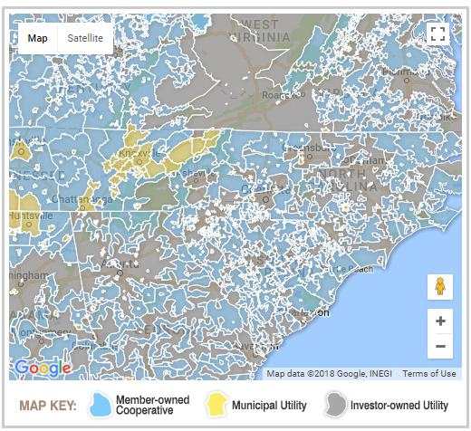
Appalachian Voice’s Blog
The Energy Savings for Appalachia campaign envisions a future in which rural electric cooperatives are investing in local economies and community health with energy efficiency, renewable energy and other initiatives that are accessible to all residents.
Locate your utility to learn more about:
How your utility compares to others in the area
Efficiency programs and incentives offered by your utility
How to get in contact with your utility
Businesses in your region that can help you improve your home's energy efficiency
Additional resources and tips to help you reduce your home energy use
Find Your Utility
Click your utility on the map
Or, choose your state and utility below:
Mission-centric questions:
How can your co-op do a better job of improving people’s lives in the communities they serve?
What best practices and programs other co-ops are offering that can also be implemented in your area?
What strategies can you use to get your co-op to develop the same practices and programs?
We Welcome You!
Appalachian Voices' Energy Savings Action Center is a tool designed to help residents in our area save money and energy by promoting energy efficiency loan programs through your electric utility. We want to connect you directly to money-saving utility programs and give YOU the leverage to make changes within your cooperative! We want to give everyone in Appalachia the tools needed to use their cooperative to the advantage of the whole community.
© 2012 Appalachian Voices • 171 Grand Blvd, Boone, NC 28607 • (877) APP-VOICE About | Contact Us | News Room | Policies |
Notes:
Drop vision statement down to bottom?
Move mission-oriented statements to center and top
-too wordy before you get to the point of the page
Want people to pull up the page and understand what they can do and how to start

Slide 2
Appalachian Voice’s Blog
The Energy Savings for Appalachia campaign envisions a future in which rural electric cooperatives are investing in local economies and community health with energy efficiency, renewable energy and other initiatives that are accessible to all residents.
Blue Ridge Electric Membership Corp.
https://www.blueridgeenergy.com/
1216 Blowing Rock Blvd. NE Lenoir NC 28645 | (828) 758-4401
Action Center Resources
What is Energy Efficiency
Home Energy Savings tips
State and Local Loan Programs
Nonprofit assistance
Sign up for updates
Tips for engaging a competent energy contractor
Find Energy Contractors in Your Area
*general note*
Your electricity provider offers a comprehensive loan program and scores highly on the Western NC utility scorecard.
Note from Rory at Appalachian Voices:
“Blue Ridge Electric Membership
Corporation has been very cooperative with our team and we appreciate the strides they have made towards comprehensive energy efficiency programs in the last few years. To meet our vision, their programs still require work to be more effective. However, the Energy SAVER loan program could be a beneficial program for you to take advantage of, if you qualify. We highly encourage you to click the Take Action button to send a note to your cooperative representative and encourage more programs for middle-income members.”
Programs Offered (Dropdown menu)
Key Facts about (Dropdown menu)
*Blue Ridge Electric*
Member Meetings
June 22, 2017
TO THE RIGHT TO THE RIGHT
Learn more about:
Incentives and programs offered by your state or utility: See the sidebar at right.
Improving Your Home: Use the map and the listing below to find efficiency experts, training centers and organizations that can help you make your home more energy efficient.
Attending public board meetings
Compare Utilities
Click to see Western NC Utility Scorecard
Take Action
Ask your cooperative to improve their services
Notes:
How to make this page more digestible? What information can be dropped into sub-pages with CLEAR headings
The map and table could be filed under Finding Energy Contractors
Drop a row in for Fixed Charge

Slide 3
Appalachian Voice’s Blog
The Energy Savings for Appalachia campaign envisions a future in which rural electric cooperatives are investing in local economies and community health with energy efficiency, renewable energy and other initiatives that are accessible to all residents.
Blue Ridge Electric Membership Corp.
https://www.blueridgeenergy.com/
1216 Blowing Rock Blvd. NE Lenoir NC 28645 | (828) 758-4401
Action Center Resources
What is Energy Efficiency
Home Energy Savings tips
State and Local Loan Programs
Nonprofit assistance
Sign up for updates
Tips for engaging a competent energy contractor
Find Energy Contractors in Your Area
*general note based on parameters*
Your electricity provider offers a comprehensive loan program and scores highly on the Western NC utility scorecard.
Note from Appalachian Voices:
“Blue Ridge Electric Membership
Corporation has been very cooperative with
Our team and we appreciate the strides they
Have made towards comprehensive energy efficiency programs in the last few years. To meet our vision, their programs still require work to be more effective. However, the Energy SAVER loan program could be a beneficial program for you to take advantage of if you qualify. We highly encourage you to click the Take Action button to send a note to your cooperative representative and encourage more programs for middle-income members.”
Programs Offered (Dropdown menu)
Energy SAVER Loan Program
Qualified members can borrow up to $7,500 for a term of up to seven years at a nominal interest rate. To qualify you must: own your home, be an active Blue Ridge member for two years, and house must have a permanent foundation, crawlspace or basement.
Smart Rebates
These rebates will help you purchase a new EnergyStar refrigerator, freezer, or high-efficiency heat pump.
Flexpay
“Pay as you go” billing
Equalized Billing
Pay a flat fee each month
Low-Income Assistance
Credit on monthly bill for those who qualify
Operation Round-up
By choosing to round your monthly energy bills up to the nearest dollar amount, you can help fund heating assistance and other community services for local families in need.
Community Solar
Subscribe to one or more panels and receive a bill credit for the energy they produce.
Image of Rory
Take Action
Ask your cooperative to improve their services
Key Facts about (Dropdown menu)
*Blue Ridge Electric*
Number of Customers: 67,458
Total Demand: 708,694 MWh/yr
Data from 2016
Member Meetings
June 22, 2017
 | *Your utility* | *State* Average
Average Household Demand (kWh/year) | 10,506
Average fixed charge ($) / Rate (c/kWh) | $24.17/ 10.1
Annual Electricity Bill | $1,170
Compare Utilities
Click to see Western NC Utility Scorecard
Notes:
How to make this page more digestible? What information can be dropped into sub-pages with CLEAR headings
The map and table could be filed under Finding Energy Contractors
Drop a row in for Fixed Charge

Slide 4
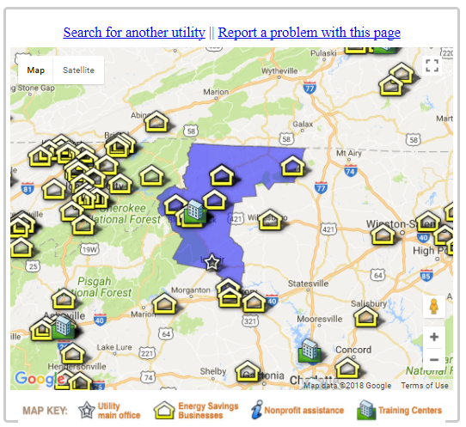
Appalachian Voice’s Blog
The Energy Savings for Appalachia campaign envisions a future in which rural electric cooperatives are investing in local economies and community health with energy efficiency, renewable energy and other initiatives that are accessible to all residents.
Blue Ridge Electric Membership Corp.
https://www.blueridgeenergy.com/
1216 Blowing Rock Blvd. NE Lenoir NC 28645 | (828) 758-4401
Action Center Resources
What is Energy Efficiency
Home Energy Savings tips
State and Local Loan Programs
Nonprofit assistance
Sign up for updates
Tips for engaging a competent energy contractor
Improving Your Home: Use the map and the listing below to find efficiency experts, training centers and organizations that can help you make your home more energy efficient.
Programs Offered (Dropdown menu)
Energy SAVER Loan Program
Qualified members can borrow up to $7,500 for a term of up to seven years at a nominal interest rate. To qualify you must: own your home, be an active Blue Ridge member for two years, and house must have a permanent foundation, crawlspace or basement.
Smart Rebates
These rebates will help you purchase a new EnergyStar refrigerator, freezer, or high-efficiency heat pump.
Flexpay
“Pay as you go” billing
Equalized Billing
Pay a flat fee each month
Low-Income Assistance
Credit on monthly bill for those who qualify
Operation Round-up
By choosing to round your monthly energy bills up to the nearest dollar amount, you can help fund heating assistance and other community services for local families in need.
Community Solar
Subscribe to one or more panels and receive a bill credit for the energy they produce.
Table of energy contractors
Key Facts about (Dropdown menu)
*Blue Ridge Electric*
Number of Customers: 67,458
Total Demand: 708,694 MWh/yr
Data from 2016
Member Meetings
June 22, 2017
 | *Your utility* | *State* Average
Average Household Demand (kWh/year) | 10,506
Average Rate (c/kWh) | 10.1
Annual Electricity Bill | $1,170
 | *Your utility* | *State* Average
Average Household Demand (kWh/year) | 10,506
Average fixed charge ($) / Rate (c/kWh) | $24.17/ 10.1
Annual Electricity Bill | $1,170
Compare Utilities
Click to see Western NC Utility Scorecard
Notes:
How to make this page more digestible? What information can be dropped into sub-pages with CLEAR headings
The map and table could be filed under Finding Energy Contractors
Drop a row in for Fixed Charge

