Slide 2
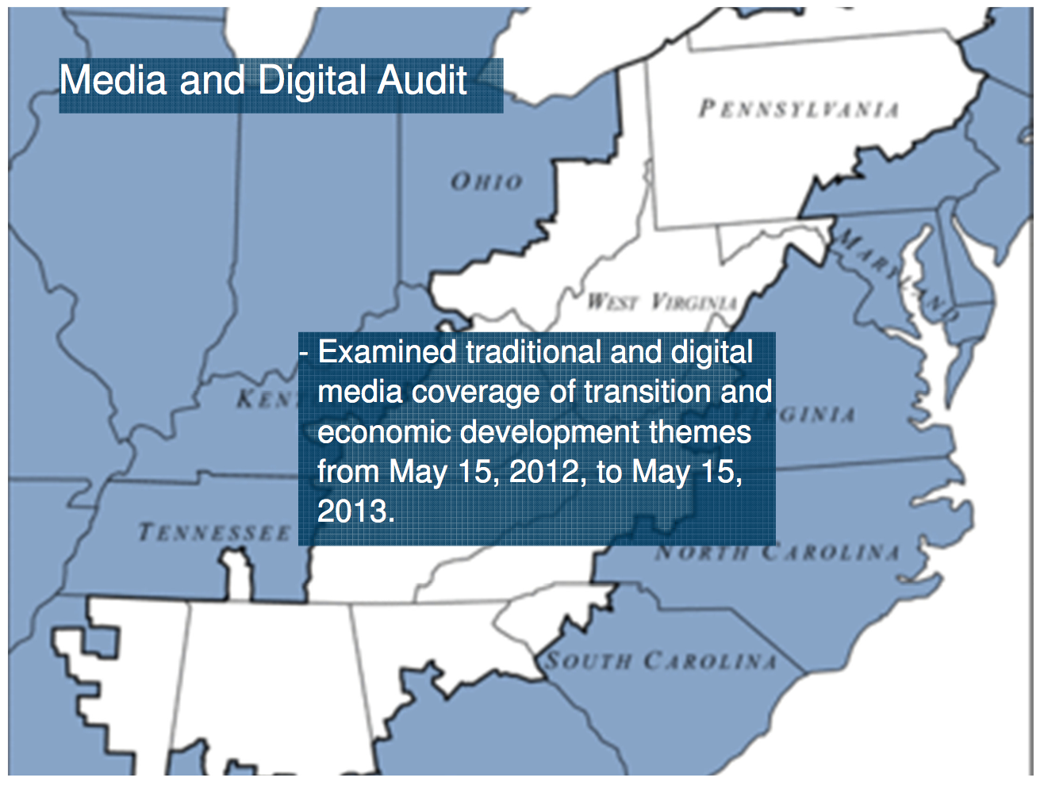

Slide 10
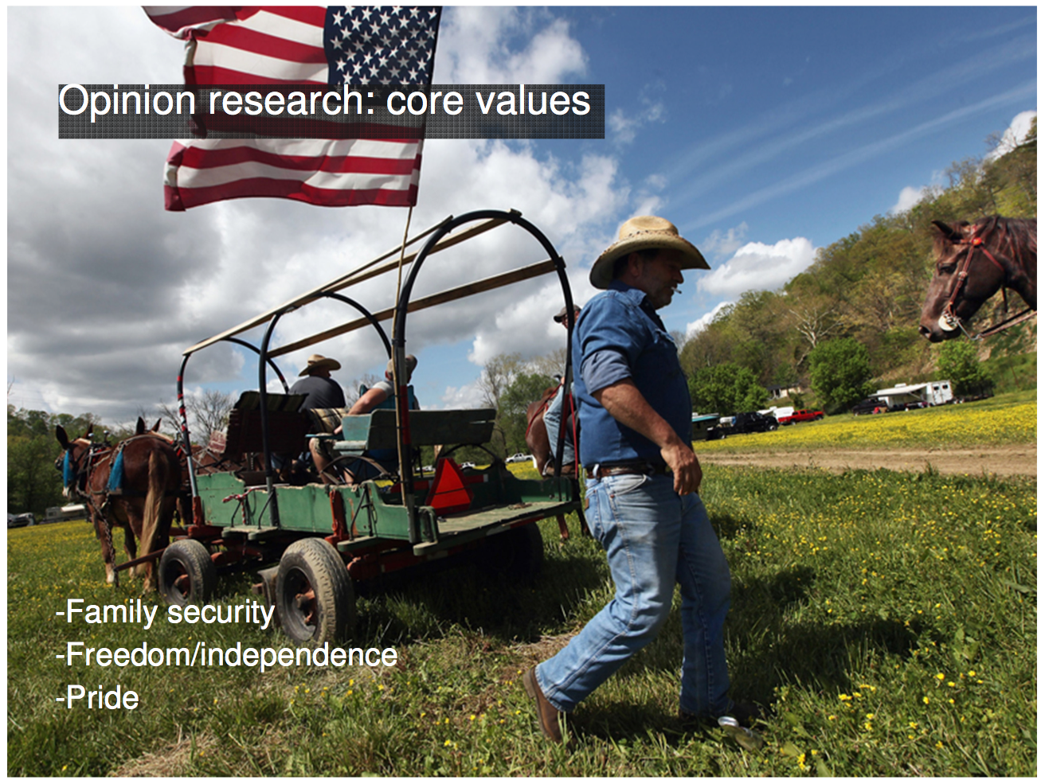

Slide 13
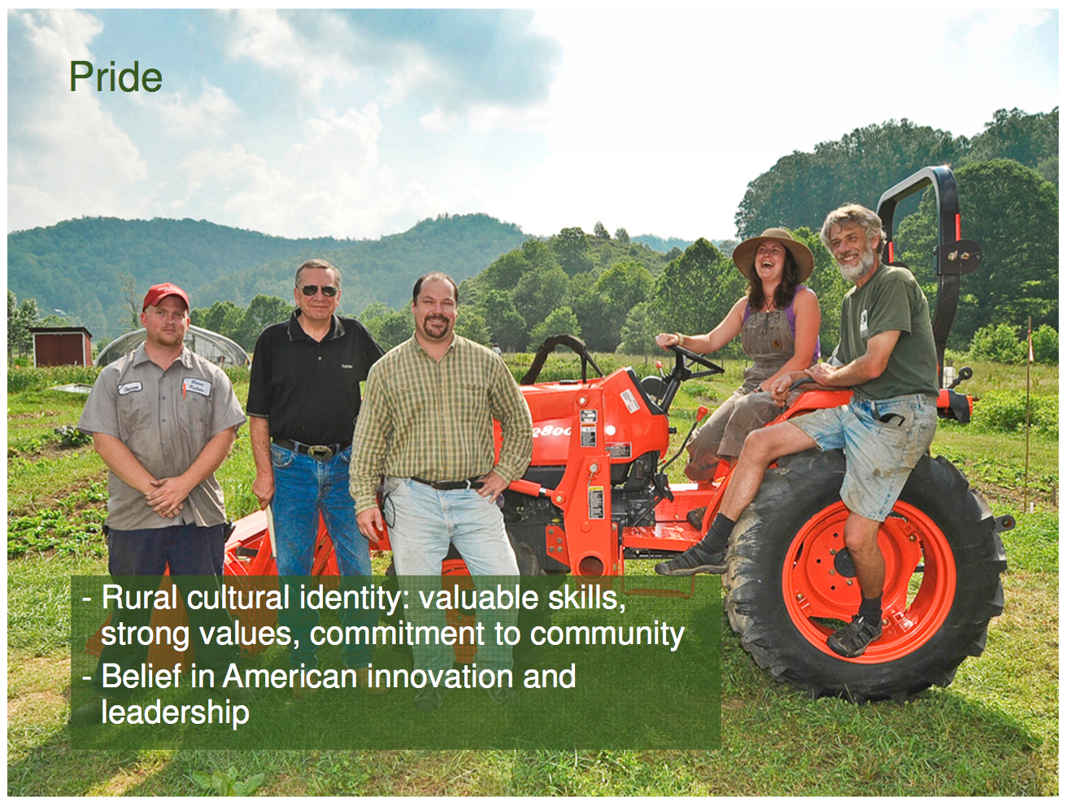

Slide 14
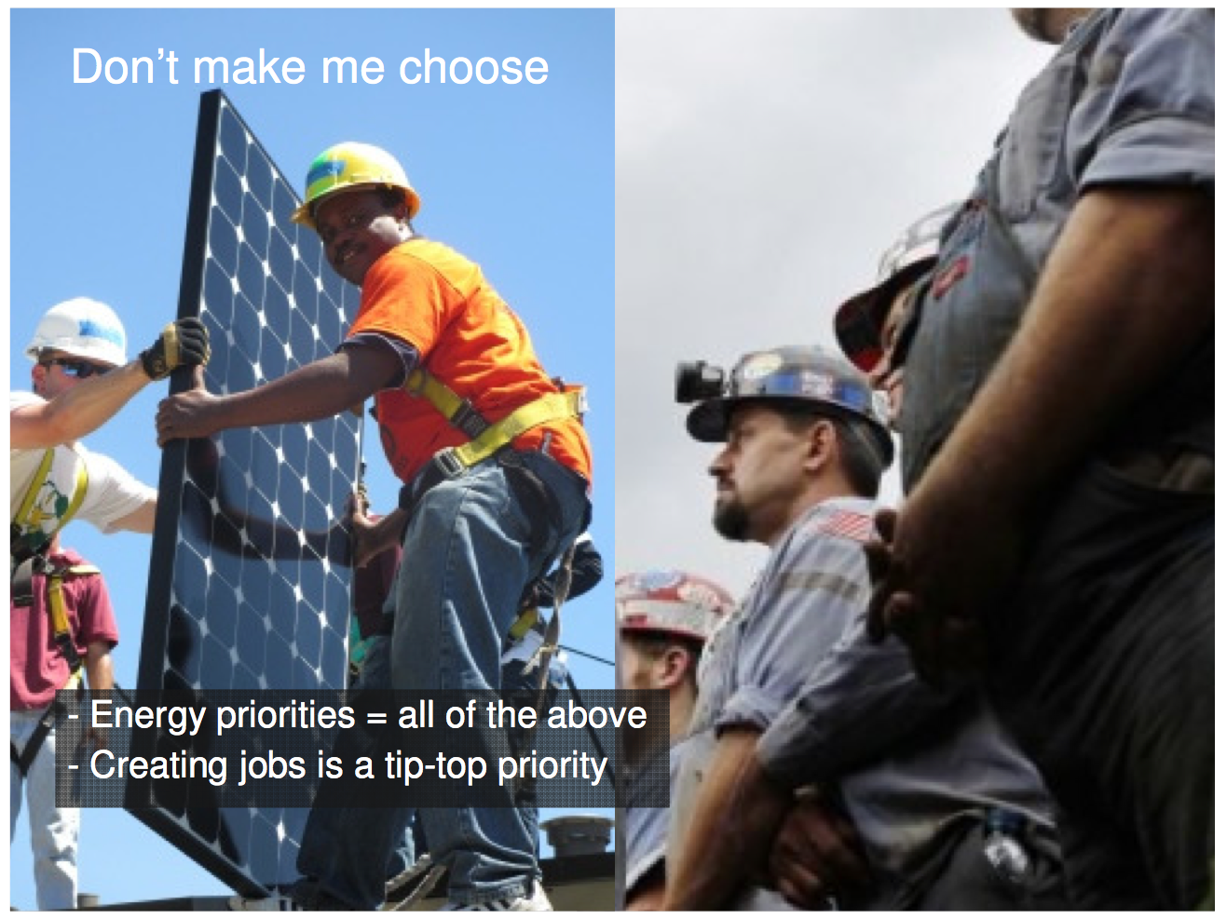

Slide 19
Changing a Dominant Narrative
Notes:
Like the Center for Investigative Journalism, the Food and Environmental Reporting Network (FERN), hires freelance journalists to investigate underreported topics and places these stories with mainstream news outlets. FERN pays its freelancers through funds raised from foundations and by selling stories in some cases to outlets. FERN staff is comprised primarily of former journalists with strong connections to several major mainstream news outlets. As national outlets trim their internal reporting capacity, they have become more open to purchasing stories produced by entities like FERN. FERN stories have been featured on major TV, print and radio outlets, including the Washington Post, ABC News and PRI World News.
Upsides: The FERN model provides a means to generate in-depth coverage of underreported issues—in this case food and farm issues—and place them in major national and regional outlets.
Downsides: The FERN model requires a fairly substantial up-front investment and ongoing funds to pay salaries and freelancer fees for journalists.

Slide 20
Changing a Dominant Narrative
Notes:
Upwell is an interesting model in that it addresses both challenges faced by Appalachian groups. Upwell describes itself as a PR agency for the ocean. Upwell staff uses sophisticated online listening tools to track online conversations about ocean issues, which it then curates (i.e. identifying the best from online content) and amplifies via a variety of means. Upwell builds on work being done by a host of oceans-oriented advocacy groups and campaigns. It looks for what is interesting, sharable and inspiring, and it repackages it and circulates it via its growing network of ocean advocates. Upwell has a website and blog and distributes a newsletter (The Tide Report) to a network of ocean communicators and online influencers. Through Upwell, advocates working on a range of oceans issues have access to timely, sharable content that they can then repost to their networks, thereby amplifying the impact of each other’s’ work. They can keep abreast of what’s happening on oceans issues while also accessing timely communications tools—for example, the Upwell blog has a recent post about a Shark Week Toolkit, which is designed to help advocates take advantage of media attention to sharks during Shark Week by providing simple shark facts, suggestions for how to drive the shark conversation, myth-busting resources and more. Participation in Upwell is entirely voluntary—there is no coordinated campaign behind it. Groups can opt in or out of any particular activity.

Slide 21
Crowd-Sourced Content
Notes:
Crowd-sourcing content can be a useful tactic to help engage members of a community – physical or virtual – in a conversation about an issue. The number and diversity of contributors can be seen as an indication of the depth and breadth of support for an issue. The inclusion of diverse views can help dispel notions that only certain kinds of stakeholders – Democrats, treehuggers, liberals, for example – are in favor of an issue. Crowd-sourcing is also sometimes seen as a means of cheaply and easily generating content for a website or social media property.
But in most cases, it’s actually quite expensive in terms of staff time to find and motivate contributors. And getting those impressive numbers, and that diversity, is even more difficult and time consuming. It’s rare for individuals to devote their time and energy to contributing content about a particular issue, even if they’re quite interested in the issue. Only the most passionate of supporters will snap and upload a photo of themselves, shoot a short video, or write a few sentences of text.
That’s why you’ll find so many examples of crowd-sourcing that offer only the impression of diversity, without much actual diversity behind them. Earthjustice’s Mountain Heroes web page, for example, garnered nearly 14,000 photos of people who want to stop mountaintop removal coal mining. Most of these are from Earthjustice’s supporters across the nation, rather than from people in the region. The few pictures and stories from within the region, such as the essays from Debbie Jarrell and Bo Webb of Coal River Mountain Watch and Chuck Nelson of the Ohio Valley Environmental Coalition, were solicited by Earthjustice and come from other advocacy organizations in the region. Bottom line? Gathering stories from real people who aren’t already affiliated with your cause is harder than it seems.

Slide 35
