Slide 1
Coal Combustion Residuals Regulatory Framework Implemented by the Division of Waste Management
Division of Waste Management
Solid Waste Section
January 12, 2012

Slide 2
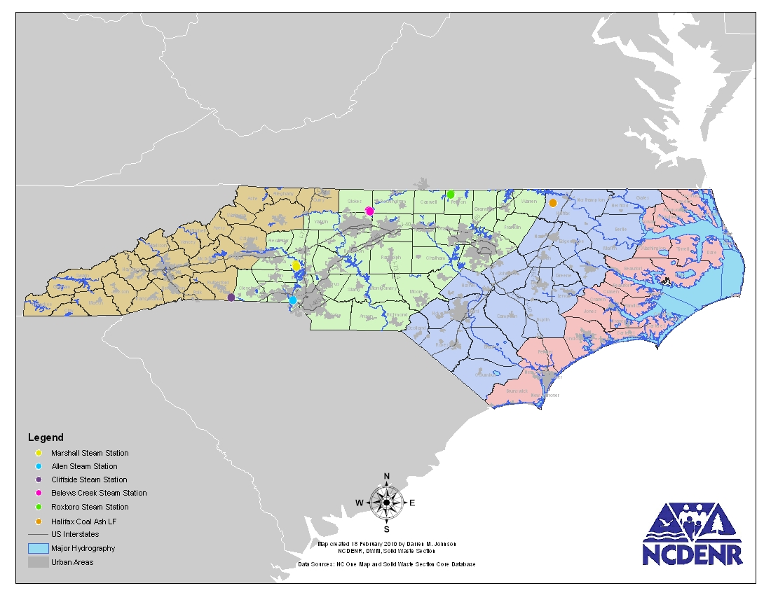
Marshall - closed ash, open ash, open FGD
Belews – closed ash, open ash, open FGD
Cliffside – open CCR
Allen – open CCR
Progress – open ash
Halifax – open ash

Slide 3
Laws/Regulations for CCR Landfills 1982
5 year permit
Controlled access from public
Shall not:
Destruct habitat of/or endangered and threatened species
restrict 100 year flood
discharge pollutants into surface water in violation of NPDES
cause violation of CWA 404
cause non-point pollution which violates assigned water quality standards
Buffers:
Waste 4- feet above groundwater
50 feet to property line, streams, rivers
500 feet to dwellings and wells
Semi-Annual Monitoring:
Groundwater
Surface water

Slide 4
Laws/Regulations for CCR Landfills updated 1995
Design ensures 2L standards are not exceeded at the compliance boundary using modeling of hydrogeology, climate and waste OR
Specified design:
Final Cover xpoir;joitr
(waste) qnmnnnmqqnn
Leachate collection xxxxxxxxxxxxxxxxxxxxxxxxxx
Flexible membrane ______________________
2 ft of clay =================================

Slide 5
Laws/Regulations for CCR Landfills - 2007
Areas that were formerly used for storage or disposal of combustion products design (or alternative equivalent):
Final Cover
Waste qnmnnnmqqnn
Leachate collection xxxxxxxxxxxxxxxxxxxxxxxxx
Flexible membrane liner
Leak detection system 
Flexible membrane liner
2 feet clay
Dry ash pond
Leak detection response plan in place-monthly monitor of flow.
Groundwater monitoring not always required but Leachate Monitoring is still required
qnmnnnmnmqqnn
Notes:
Final Cover – 2 ft

Slide 6
Permit Conditions for CCR Landfills
S & E controls
Ground & surface water, leachate semiannual monitoring & reporting
Wells installed with LG or PE present, final locations/screen intervals/nesting of wells as approved by SWS
Dust visually observed on hourly basis if problematic Plan initiated. Resin, concretion, soil or water.
Final cover = membrane drainage layer, 18 in soil, vegetative cover.
Financial assurance, with annual updates of costs of closure, post closure care
Scales record waste weight, annual reporting to SWS of monthly tons and which county waste originated
Certified facility operator onsite
Edge of waste permanently marked

Slide 8
Proposed landfills
Duke - Belews Creek Craig Rd Landfill 8504, 124 acre greenfield expansion. Site suitability issued on 11/8/11
Progress Energy - Mayo Power Plant 73XX, 104 acres, Person County, greenfield, Site Suitability application in house

Slide 9
Landfills at Power Plants in North Carolina
Permit ID | County | Permit Name | Status | Liner System | Most Recent PTO Date | Previous Landuse | Acreage | FGD | Ash | GW Monitoring
1804-INDUS-1983 | Catawba | Duke Energy-Marshall Steam Station (Abestos & C&D) | Closed (June 2008) | unlined |  | greenfield | 61 |  | a | a
1809-INDUS | Catawba | Duke Energy-Marshall Steam Station (FGD Residual) | Active | lined w/ LCS | Nov 2011 | greenfield | 31.9 | a |  | a
1812-INDUS-2008 | Catawba | Duke Energy-Marshall Steam Station (Indus Landfill #1) | Active | double lined w/ LCS & LDS * | Mar 2011 | Phase 1-greenfield & retired ash pond | 93.4 |  | a | leak detection system
3612-INDUS-2008 | Gaston | Duke Energy-Allen Steam Station (RAB Landfill) | Active | double lined w/ LCS & LDS | Dec 2010 | retired ash basin | 47 | a | a | leak detection system
8106-INDUS | Rutherford | Duke Energy-Cliffside Steam Station | Active | lined w/ LCS | Sept 2010 | greenfield | 85 | a | a | a
85030-INDUS-1984 | Stokes | Duke Energy-Belews Creek Steam Station (Pine Hall Rd LF) | Closed (Dec 2007) | unlined |  | greenfield |  |  | a | a
8504-INDUS | Stokes | Duke Energy-Belews Creek Steam Station (Craig Rd LF) | Active | lined w/ LCS | Nov 2007 | greenfield | 90 | a | a | a
8505-INDUS | Stokes | Duke Energy-Belews Creek Steam Station (FGD Residual) | Active | lined w/ LCS | Jan 2008 | greenfield | 22.6 | a |  | a
7302-INDUS | Person | Progress Energy-Roxboro | Active | lined w/ 40mL LLDPE-GM | July 2007 | lined landfill over unlined landfill over retired ash basin | 71 | a | a | a
7302-INDUS | Person | Progress Energy-Roxboro | Closed 2002 | unlined |  | unlined landfill over retired ash basin | 113 |  | a | a
 |  |  | *LDS - leak detection system, LCS - leachate collection system

Slide 10
Structural Fills
Regs require buffers: 25 ft to property line,
2 feet to groundwater,
50 feet to streams and wetlands,
25 feet to bedrock outcrop,
100 ft to wells, springs, drinking water
Closure requirements 12 inch compacted soil + 6 inch soil capable of plant growth.
Dust control
Side slopes of 3H:1V
Beneficial end use

Slide 11
Proposed Federal Regs
Hazardous and Solid Waste Management System; Identification and Listing of Special Wastes; Disposal of Coal Combustion Residuals From Electric Utilities; Proposed Rule Proposed Rule: June 2010 concerning proposed subtitle D (solid waste) or Subtitle C (haz waste) regulations.
Comments were sent Nov 2010 (proposed rule)
Nov 2011 comments were sent concerning comments from public meetings and documentation within docket.
No timetable of final rule.
Effluent Guidelines for Steam Electric Plants. draft due out July 2012, final 2014

Slide 12
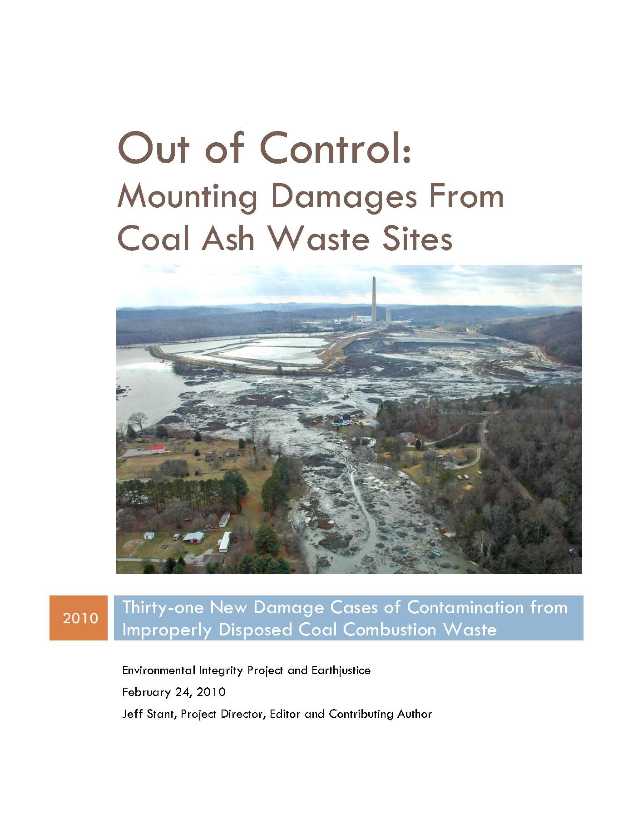
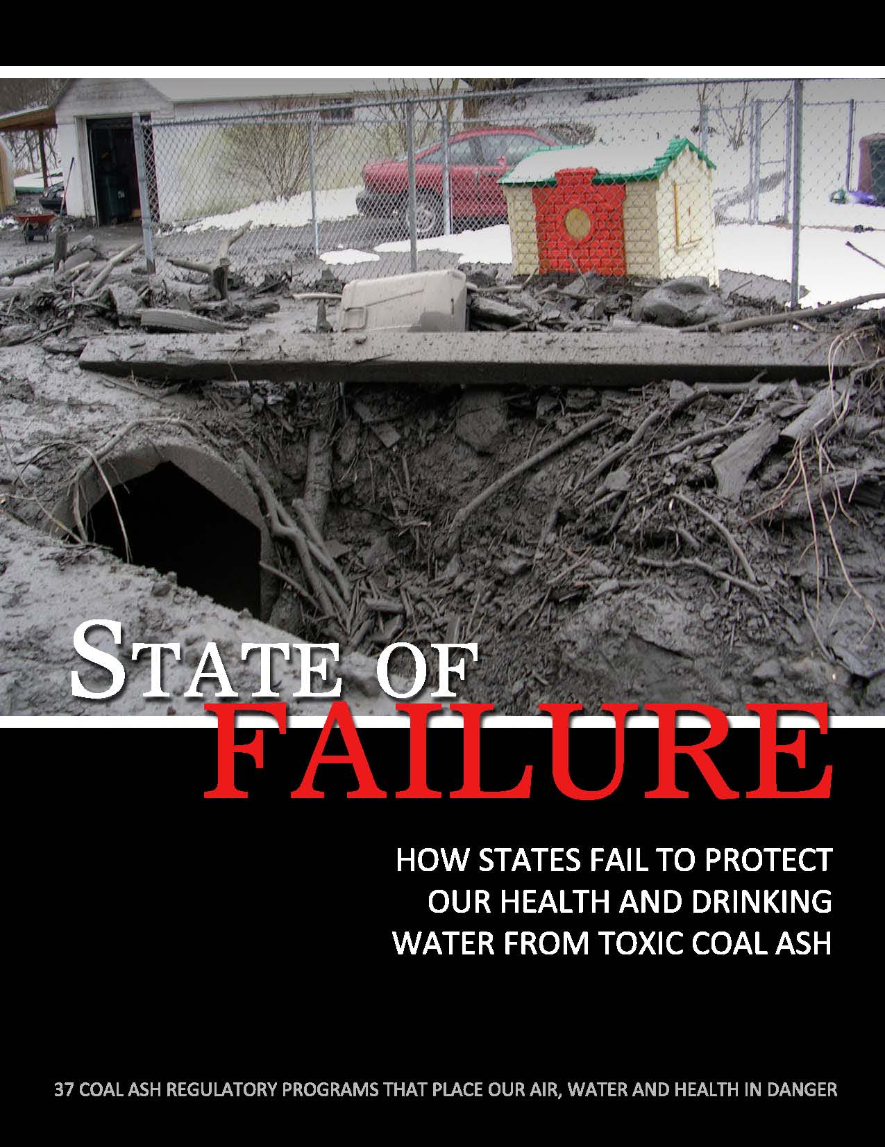

Slide 13
Comments received regarding CCR landfills and structural fills
Groundwater exceedances of 2L standards at all landfills except for Halifax, primarily Fe, Bo, Se – assessment underway.
Structural fill (Fountain Industrial) was used to park FEMA trailers after Hurricane Floyd. Ash was exposed. HHS responded to complaint and closed case after soil sampling revealed no risk.
Groundwater exceedances (Swift Creek) at the only structural fill with wells. Wells were installed after compliance action – construction plans were not followed and ash was placed close/possibly in wetlands. Elevated levels of metals continue.

Slide 14
Comments received regarding CCR landfills and structural fills – cont.
Compliance issues (2) current at structural fills include
severe erosion at site
end use was “building site” but building never constructed

Slide 15
For additional information contact:
Ellen Lorscheider
Solid Waste Section
Division of Waste Management
919-707-8245
Ellen.Lorscheider@ncdenr.gov
www.wastenotnc.org

Slide 16
Duke Marshall – Dry Ash, #1804

Slide 17
Duke Marshall – Industrial LF#1, #1812

Slide 18
Duke Marshall – FGD, #1809

Slide 19
Duke Allen – Retired Ash Basin LF, #3612

Slide 20
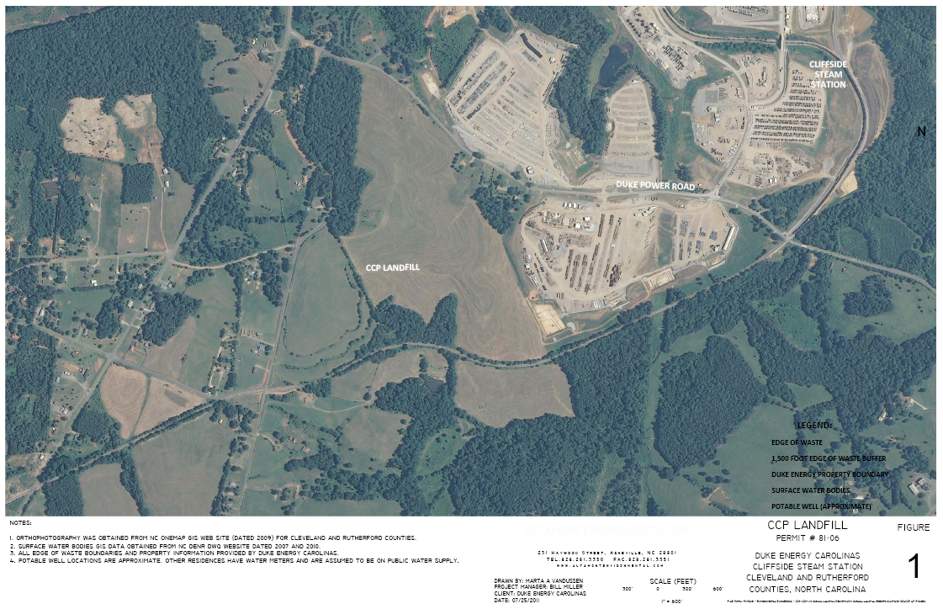
Duke Cliffside – CCP LF, #8106

Slide 21
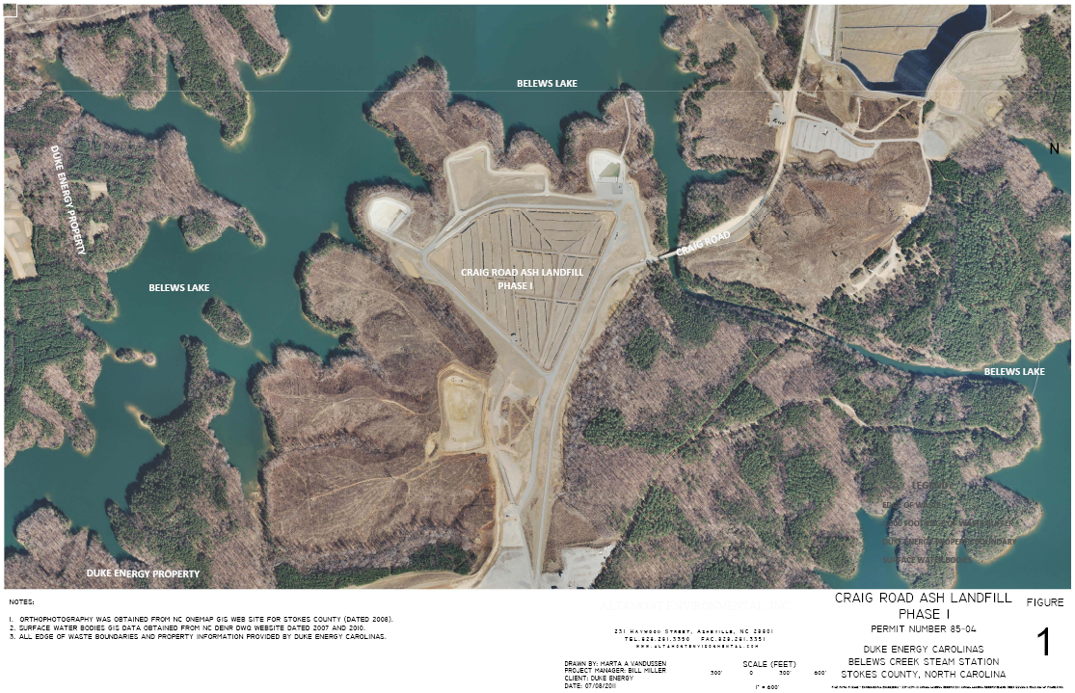
Duke Belews Creek – Craig Rd, #8504

Slide 22
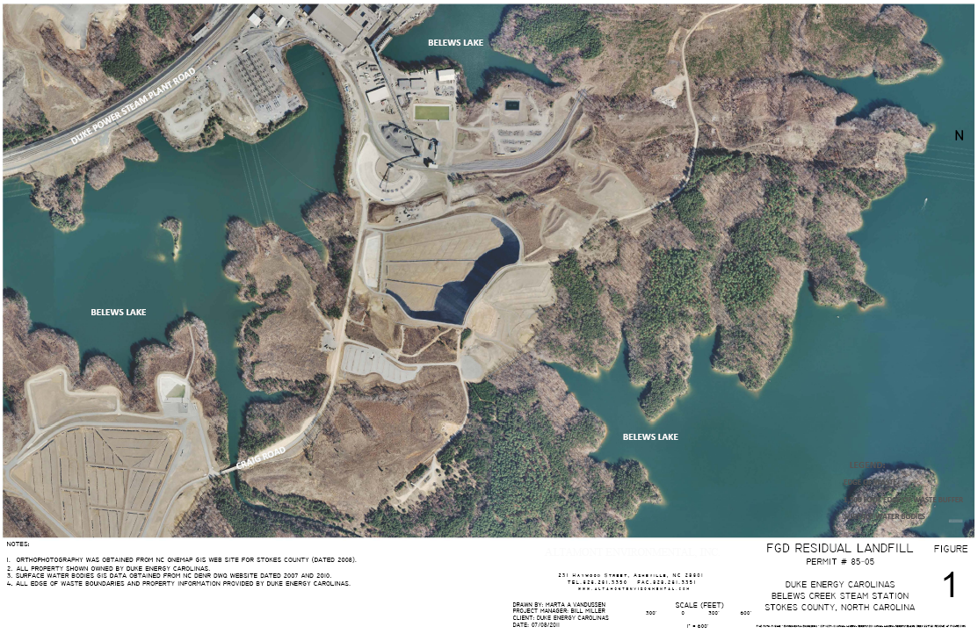
Duke Belews Creek – FGD LF, #8505

Slide 23
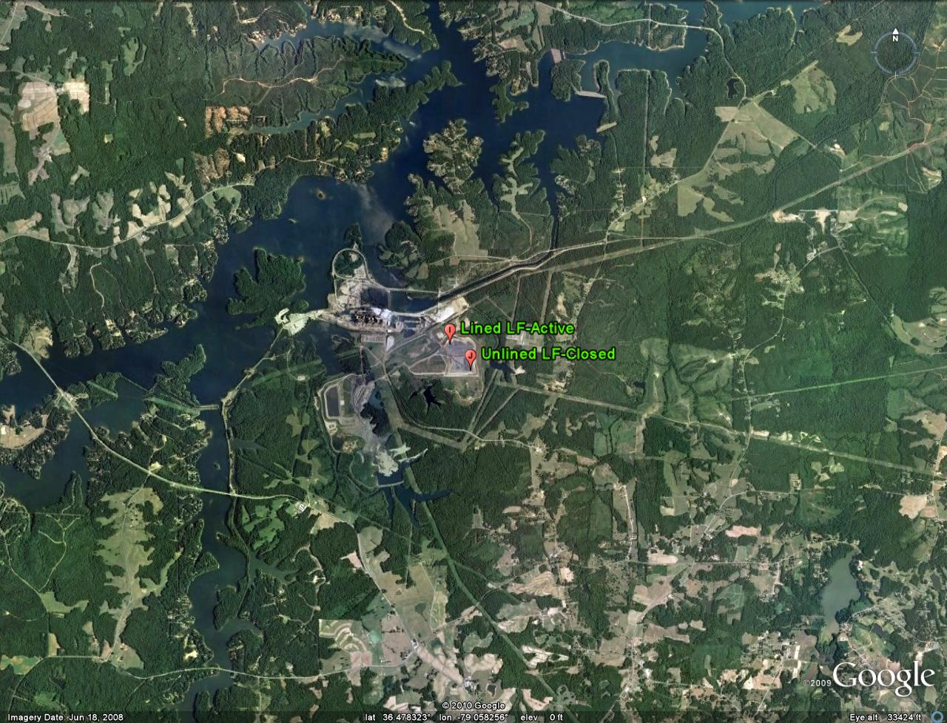
Progress Energy Roxboro - #7302
Progress Energy – Roxboro Steam Station
Roxboro, NC – Person County

Slide 24
For additional information contact:
Ellen Lorscheider
Solid Waste Section
Division of Waste Management
919-707-8245
Ellen.Lorscheider@ncdenr.gov
www.wastenotnc.org

